Slide 1

Data Analysis & Visualization for Business Insights
Power Bi Dashboard for BTR. Pvt. Ltd.
Presented By: THAKUR ROHIT SINGH
Internship Duration: 1ST Jan 2025 – 15th May 2025

Slide 2
Introduction to Power BI
What is Power BI?
- Business intelligence tool for data visualization
- Helps in making data-driven decisions
Why BTR Needs Power BI?
- Track sales, inventory, and customer trends
- Improve operational efficiency

Slide 3
Project Goals & Objectives
Main Goal:
- Design Power BI dashboard for sales/inventory tracking
Objectives:
- Collect and clean data from multiple sources
- Create interactive dashboards
- Enable data-driven decisions

Slide 4
SYNTHETIC DATA CREATION
Main Goal:
- creating relevant synthetic data for analysis
Objectives:
- multiclass dataset .
- Create dataset with relevant figures
-optimizing code for outliers and noise which could disrupt analysis.

Slide 5
Data Sources & Integration
Data Sources:
- Excel (sales, inventory, customers)
- SQL Server (warehouse data)
- ERP System (supply chain)
ETL Process:
- Clean and transform using Power Query/PYTHON

Slide 6
Data Modeling & Relationships
Tables Used:
- Sales Data (Product, Region, Revenue)
- Inventory Data (Stock Levels)
- Customer Data
Relationship Model:
- Star Schema for efficiency

Slide 7
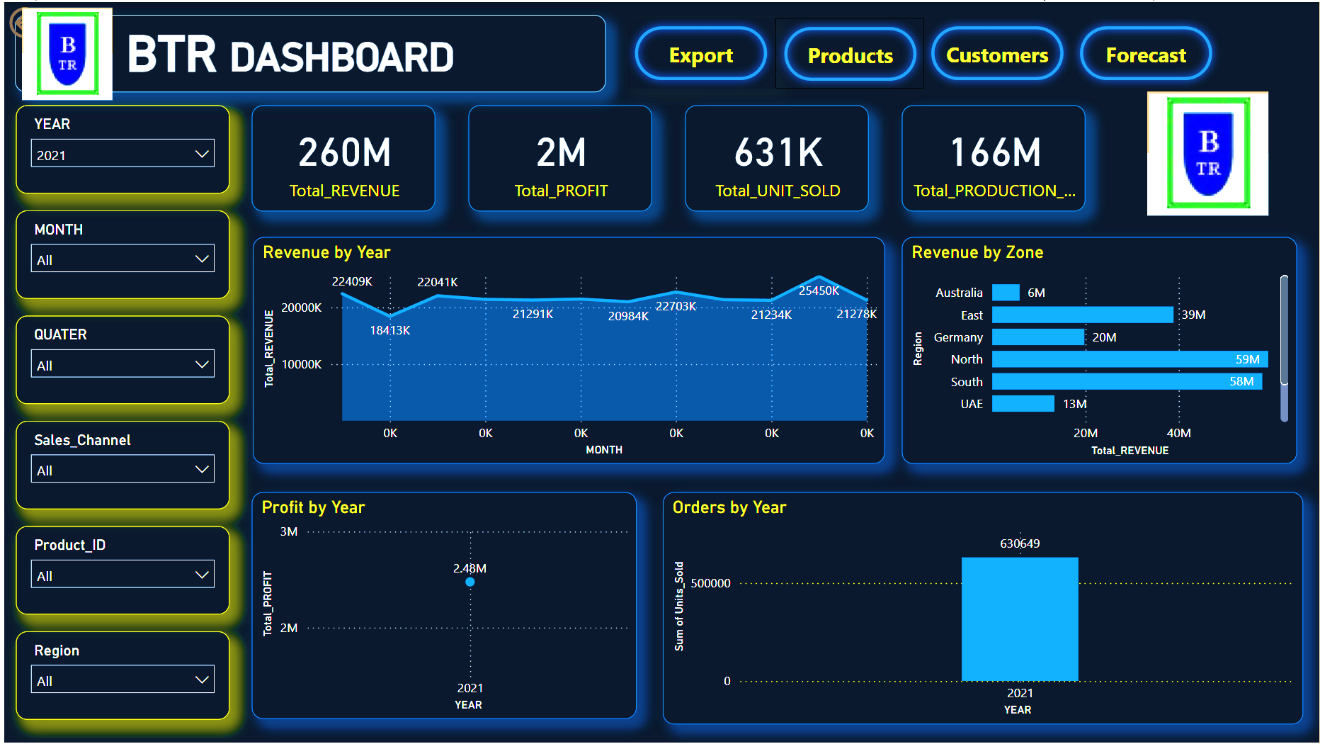
Dashboard Overview

Slide 8

Key Performance Indicators
- Total Sales (X Million)
- Sales Growth (X%)
- Inventory Turnover
- Customer Retention (X%)

Slide 9
Data Visualizations
- Bar Charts: Sales by region
- Line Charts: Monthly trends
- Map Charts: Customer segments over Countries
- KPI Cards: Key performance metrics

Slide 10

Interactive Features
Filters:
- Region, Product, Time Period
Drill-through:
- Click products for details
To extract data of relevance only

Slide 11
DAX Measures
TOTAL SALES = SUM(Sales[Revenue])
GROWTH % = DIVIDE([Current]-[Previous],[Previous])
INVENTORY TURNOVER = DIVIDE(Sales,Inventory)

Slide 12
Business Impact
- Identify top or bottom n products
- Optimize inventory levels to prevent underflow or overflow.
- Targeted marketing to cater to customers with specific requirements

Slide 13
Challenges & Solutions
Challenge | Solution
Large dataset | Used aggregated tables
Data inconsistencies | Power Query/ Python cleaning
Real-time needs | Scheduled refresh / Integration with api’s(in future)

Slide 14
Future Enhancements
- AI predictive analytics using custom model
- Real-time streaming using api’s

Slide 15
Conclusion & Q&A
- Summary of achievements
- Open for questions

